Slide 1
?
All rights reserved. DataSelf is a trademark of DataSelf Corp. All other marks and images belong to their respective owners.
Notes:
So many BI choices. Which one is the right fit for you? What are the pros and cons?
17 years, education about making your BI journey successful regardless of what tool you pick

Slide 2
DataSelf and Tableau
BI, analytics and data warehousing
Presenter: Joni Girardi, DataSelf Founder & CEO
Copyright © 2017 DataSelf Corporation. All rights reserved. DataSelf is a trademark of DataSelf Corp. All other marks and images belong to their respective owners and the descriptive use of such marks and images does not indicate that such
respective owners are in any way connected to or endorsing DataSelf Corp or its initiatives.

Slide 3
Agenda
The successful BI journey
DataSelf overview and demo
Q&A

Slide 4
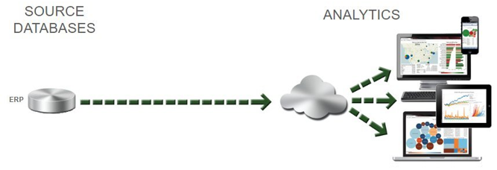
A regular BI journey
Expensive
Hard to maintain
Performance issues
Scratch it all?
Notes:
It works for inexpensive BI needs! It grows organically.
But for many organizations, this journey becomes expensive.

Slide 5
A more structured BI journey
Data consolidation,
single version of the truth,
speed,
easy for reporting.
Ease of use,
speed,
anytime & anywhere.
BI expertise.
Notes:
The more structured BI journey is for companies with more expensive and complex BI needs .
Labor and performance issues when querying live source systems. The value of bringing data together. Single version of the truth.
Analytics: really easy to use; run reports in seconds, and be available anytime and anywhere.
BI expertise: to choose, deploy and maintain.

Slide 6
Ingredients for a Successful BI Journey
The BI platform
BI expertise
Decision makers’ engagement.
Notes:
BI platform: right platform? outgrowing? fast enough?
BI expertise: inexpensive BI needs? BI needs are complex and expensive?
Decision makers: Sounds obvious. But it’s not. In many organizations, IT and accounting departments, and management doesn’t get properly engaged. Guess what? Low budget, high failure rates, frustration and many people fired.

Slide 7
Which BI journey is right for you?
Inexpensive BI issues: Regular
Expensive BI issues: Structured
Notes:
Lots of offers for inexpensive BI issues.
If you’d have expensive BI issues, you were stuck with Fortune 2000 BI vendors and would spend a ton of money and time to get your BI project moving. And guess what, such projects have a high failure rate. Why? Well, if a project is taking year-plus to complete, and if you have some turnover in the team, quite often the project falls apart.
I saw those issues and decided that my team expertise could be of great value to these larger mid-sized organizations.

Slide 8
Poll #1
What are you main reporting challenges?
Notes:
Lots of offers for inexpensive BI issues.
If you’d have expensive BI issues, you were stuck with Fortune 2000 BI vendors and would spend a ton of money and time to get your BI project moving. And guess what, such projects have a high failure rate. Why? Well, if a project is taking year-plus to complete, and if you have some turnover in the team, quite often the project falls apart.
I saw those issues and decided that my team expertise could be of great value to these larger mid-sized organizations.

Slide 9
DataSelf Analytics
Top-ranked enterprise-grade BI
Out of the box
BI expertise
Notes:
That’s how DataSelf came to life. An company and solution that brings 3 main values to the table.
Expertise: we do this day and day out. We know a lot about mid-market data sources such as ERP, CRM, payroll, Google Analytics. We know a lot about BI tools and platforms and how to put them together for business value.
BI platform: we’re always looking for the latest and greatest BI, and be sure that is very high performance and mature.
Finally, instead of starting your project with a blank sheet, we provide a ton of preconfigured templates.

Slide 10
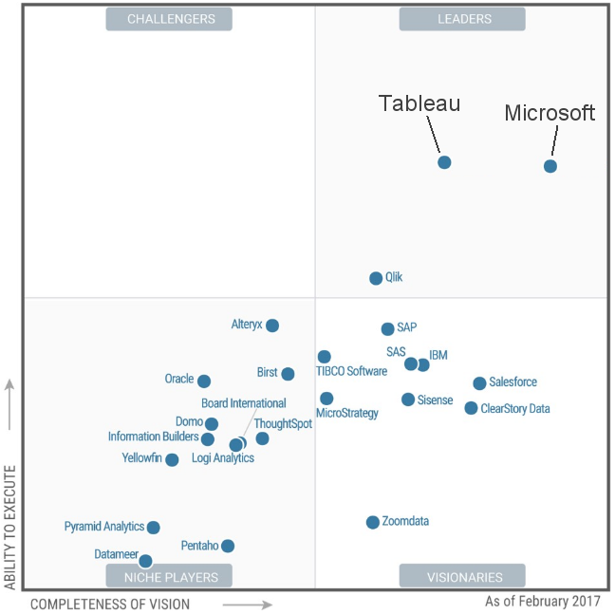
Latest Gartner Magic Quadrant for
BI and Analytics Platforms

Slide 11
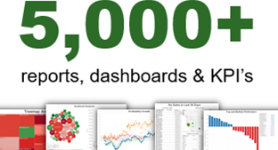
DataSelf Analytics Architecture
Notes:
So, this platform is very robust, very easy to use and runs reports really fast. Reports will run in seconds regardless of how much data you have.
You can put together a similar framework like this, yes you can! But typically it will take years to bring all of your critical data to meaningful reports and dashboards. Maybe you start with your sales or financials, but eventually you’ll bring your AP, AR, inventory, PO, services, maybe CRM, Google Analytics and Excel files. It’s just a lot of work and experimentation! You can absolutely do it, but do you have the time, money and expertise to make this efficiently? We saw that problem and started to crowdsource our report templates. A client created a new interesting report, and we add that template to our library. Today, we have more than 5,000 reports and dashboards. There’s more than 2,000 for sales analysis. More than 500 for financial analysis. More than 1,000 for CRM. There’s a lot!

Slide 12
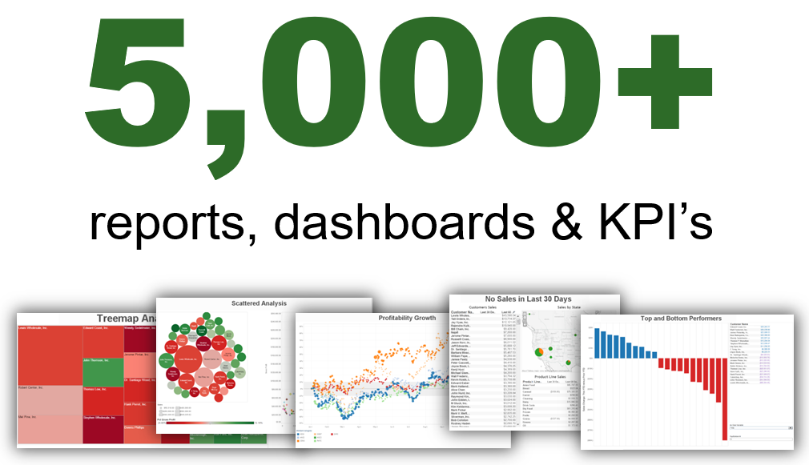
?
Notes:
Now, why would you want 5,000 reports?
Case 1: you don’t have what I need
Case 2: I don’t know what to look for

Slide 13
Poll #2
What are you main reporting areas?
Notes:
Lots of offers for inexpensive BI issues.
If you’d have expensive BI issues, you were stuck with Fortune 2000 BI vendors and would spend a ton of money and time to get your BI project moving. And guess what, such projects have a high failure rate. Why? Well, if a project is taking year-plus to complete, and if you have some turnover in the team, quite often the project falls apart.
I saw those issues and decided that my team expertise could be of great value to these larger mid-sized organizations.

Slide 14
A CEO creating a new dashboard for monthly board meetings
Product demo

Slide 15
Why DataSelf Analytics?
Top-ranked enterprise-grade BI
Out of the box
BI expertise
Notes:
That’s how DataSelf came to life. An company and solution that brings 3 main values to the table.
Expertise: we do this day and day out. We know a lot about mid-market data sources such as ERP, CRM, payroll, Google Analytics. We know a lot about BI tools and platforms and how to put them together for business value.
BI platform: we’re always looking for the latest and greatest BI, and be sure that is very high performance and mature.
Finally, instead of starting your project with a blank sheet, we provide a ton of preconfigured templates.

Slide 16
Poll #2
What would you like to do next?
Notes:
Lots of offers for inexpensive BI issues.
If you’d have expensive BI issues, you were stuck with Fortune 2000 BI vendors and would spend a ton of money and time to get your BI project moving. And guess what, such projects have a high failure rate. Why? Well, if a project is taking year-plus to complete, and if you have some turnover in the team, quite often the project falls apart.
I saw those issues and decided that my team expertise could be of great value to these larger mid-sized organizations.

Slide 17
?
Q&A

Slide 18
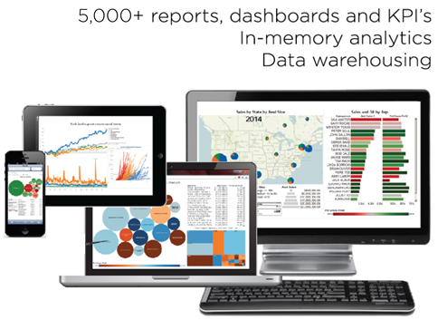
Thank you!
Joni Girardi, DataSelf Corp. CEO & Founder
(408) 674.8003 jgirardi@dataself.com www.dataself.com
Copyright © 2017 DataSelf Corporation. All rights reserved. DataSelf is a trademark of DataSelf Corp. All other marks and images belong to their respective owners and the descriptive use of such marks and images does not indicate that such
respective owners are in any way connected to or endorsing DataSelf Corp or its initiatives.

