Slide 1
Version 10.3:
Tableau and DataSelf Analytics
Presenter: Joni Girardi, DataSelf Founder & CEO
Copyright © 2017 DataSelf Corporation. All rights reserved. DataSelf is a trademark of DataSelf Corp. All other marks and images belong to their respective owners and the descriptive use of such marks and images does not indicate that such
respective owners are in any way connected to or endorsing DataSelf Corp or its initiatives.

Slide 2
Agenda
Tableau / DataSelf Analytics v10.3:
Automatic query caching
Web authoring
Tooltip selection
Latest date presets
Alerts
Other
DataSelf Templates
Core Financials
Distribution
CRM

Slide 3
Automatic Query Caching
Faster performance on initial user load
http://onlinehelp.tableau.com/v10.3/server/en-us/perf_workbook_scheduled_refresh.htm

Slide 4
Web authoring
Format numbers more easily
Drill up on continuous axes
Change display options for maps
Create bins
Publish embedded data sources
Distribute evenly in dashboards
Create stories and dots for navigation
Web authoring: https://www.tableau.com/learn/tutorials/on-demand/web-authoring-server
Story points: https://www.tableau.com/learn/tutorials/on-demand/story-points
Layout containers: http://onlinehelp.tableau.com/current/pro/desktop/en-us/qs_layout_containers.html
Layout containers: https://www.interworks.com/blog/tspaulding/2013/08/07/understanding-layout-containers-tableau
Layout containers: https://www.youtube.com/watch?v=voAVa4OD_5I

Slide 5
Tooltip selection
Easily see how related data is performing
https://www.tableau.com/about/blog/2017/4/sharpen-your-analysis-tooltip-selection-tableau-103-68761

Slide 6
Latest date presets
Set filters to display latest date values automatically.
https://onlinehelp.tableau.com/v10.3/pro/desktop/en-us/help.html#filtering.html#LatestDatePresets

Slide 7
Alerts
Self-service, data-driven alerts
Just 3 easy steps:
Select axis
Click Alert
Choose sending condition
Available on charts with a continuous axis
https://www.tableau.com/learn/tutorials/on-demand/data-driven-alerts
https://www.tableau.com/about/blog/2017/4/save-time-data-driven-alerts-tableau-103-67888
https://onlinehelp.tableau.com/current/pro/desktop/en-us/data_alerts.html

Slide 8
How to consume data?
Automatic delivery
Alerts
Subscriptions
Automatic distribution
Self-service
In the flow

Slide 9
Other v10.3 Improvements
Apply table calc filters to totals https://goo.gl/sFtRdP
Maps data http://onlinehelp.tableau.com/current/pro/desktop/en-us/maps.html
Mobile updates https://onlinehelp.tableau.com/current/mobile/mobile-admin/en-us/admin_mobile_intro.html
Smart table & join recommendations https://goo.gl/9fjK42
PDF connector https://www.tableau.com/about/blog/2017/3/cut-data-prep-time-pdf-connector-and-union-updates-tableau-103-67643
More data connectors http://onlinehelp.tableau.com/current/pro/desktop/en-us/help.htm#exampleconnections_overview.html
Tableau bridge https://www.tableau.com/about/blog/2017/5/introducing-tableau-bridge-live-queries-premises-data-tableau-online-70767
Union updates https://onlinehelp.tableau.com/current/pro/desktop/en-us/union.html
API updates
REST: http://onlinehelp.tableau.com/current/api/rest_api/en-us/REST/rest_api_whats_new.htm
Java Script: https://onlinehelp.tableau.com/current/api/js_api/en-us/JavaScriptAPI/js_api_whats_new.htm
Summary of all improvements:
https://dataself.com/dataself-analytics-10-3/
https://www.tableau.com/new-features/10.3

Slide 10
DataSelf New Templates
Core Financials (1,700+ KPIs)
Financial Analytics (800 KPIs)
Payables (350 KPIs)
Receivables (550 KPIs)
CRM (1,800+ KPIs)
Account (50 KPIs)
Activity (50 KPIs)
Cases (680 KPIs)
Lead (50 KPIs)
Opportunities (1,000 KPIs)
Distribution (5,000+ KPIs)
Inventory (800 KPIs)
Purchasing (500 KPIs)
Sales (1,300 KPIs)
Sales Order (2,400 KPIs)
Summary: https://dataself.com/templates/
Samples: http://www.dataself.com/dashboard-samples
Complete list: http://www.dataself.com/brochures/DataSelfAnalyticsOOTB.xls

Slide 11
?
Q&A

Slide 12
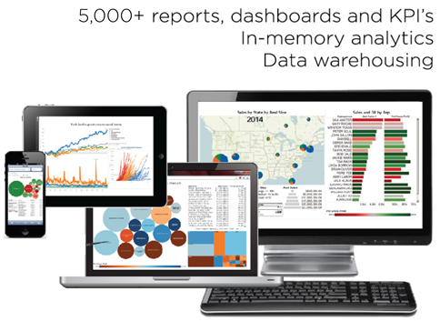
Thank you!
Joni Girardi, DataSelf Corp. CEO & Founder
(408) 674.8003 jgirardi@dataself.com www.dataself.com
Copyright © 2017 DataSelf Corporation. All rights reserved. DataSelf is a trademark of DataSelf Corp. All other marks and images belong to their respective owners and the descriptive use of such marks and images does not indicate that such
respective owners are in any way connected to or endorsing DataSelf Corp or its initiatives.

Slide 13
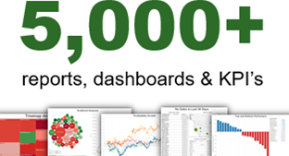
DataSelf Analytics Architecture
Notes:
So, this platform is very robust, very easy to use and runs reports really fast. Reports will run in seconds regardless of how much data you have.
You can put together a similar framework like this, yes you can! But typically it will take years to bring all of your critical data to meaningful reports and dashboards. Maybe you start with your sales or financials, but eventually you’ll bring your AP, AR, inventory, PO, services, maybe CRM, Google Analytics and Excel files. It’s just a lot of work and experimentation! You can absolutely do it, but do you have the time, money and expertise to make this efficiently? We saw that problem and started to crowdsource our report templates. A client created a new interesting report, and we add that template to our library. Today, we have more than 5,000 reports and dashboards. There’s more than 2,000 for sales analysis. More than 500 for financial analysis. More than 1,000 for CRM. There’s a lot!

