Slide 1
DataSelf Power User Training S1
Reports and Dashboards 101
Presenter: Joni Girardi, DataSelf Founder & CEO
Copyright © 2017 DataSelf Corporation. All rights reserved. DataSelf is a trademark of DataSelf Corp. All other marks and images belong to their respective owners and the descriptive use of such marks and images does not indicate that such
respective owners are in any way connected to or endorsing DataSelf Corp or its initiatives.

Slide 2
Agenda
Goals (training using v10.3, many features applicable since v9.3)
A glimpse of the possibilities
Preparation
Data source overview
Creating new report
Saving
Editing
Filtering by buckets, relative, to-date
Totals
Sorting
Charts
Dashboard
Number formatting
Exporting to Excel
Subscriptions and alerts

Slide 3
?
Q&A

Slide 4
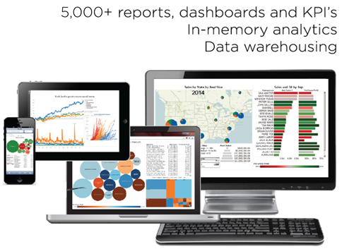
Thank you!
Joni Girardi, DataSelf Corp. CEO & Founder
(408) 674.8003 jgirardi@dataself.com www.dataself.com
Copyright © 2017 DataSelf Corporation. All rights reserved. DataSelf is a trademark of DataSelf Corp. All other marks and images belong to their respective owners and the descriptive use of such marks and images does not indicate that such
respective owners are in any way connected to or endorsing DataSelf Corp or its initiatives.

